Slide 1
Web Application

Slide 2
Agenda
Evolution of Web
What is Web Application?
Understanding Web application development players
Structure of Web Application
Major web application types
Complexity of web applications
Web application development process
Advantages / Disadvantages

Slide 3
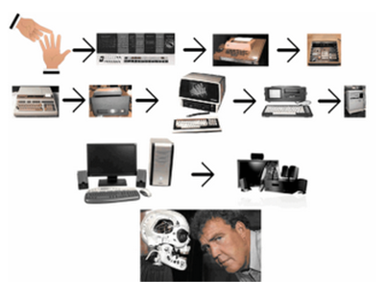
Evolution of Web

Slide 4
Evolution of Web
Before web
Memory extender
Hypertext, hypermedia
Internet
ARPA net work
TCP IP with more than 3 million host computers
Tim Berners-Lee
WWW (World Wide Web)
Web: “Evolution or Intelligent Design?”
1st, 2nd , 3rd generation web applications

Slide 5
Agenda
Evolution of Web
What is Web Application?
Understanding Web application development players
Structure of Web Application
Major web application types
Complexity of web applications
Web application development process
Advantages / Disadvantages

Slide 6
What is Web Application?
Accessed via a web browser over a network
A computer software application that is hosted in a browser-controlled environment or coded in a browser-supported language and reliant on a common web browser to render the application executables.

Slide 7
What is Web Application?
Web browser
Network
Intranet, Internet
Browser Controlled Environment / Browser-supported language
Executables

Slide 8
What is Web Application?
What is a Client?
What are the Benefits of a Web Application?
How Long Have Web Applications Been Around?
What is the Future of Web Applications?

Slide 9
Agenda
Evolution of Web
What is Web Application?
Understanding Web application development players
Structure of Web Application
Major web application types
Complexity of web applications
Web application development process
Advantages / Disadvantages

Slide 10
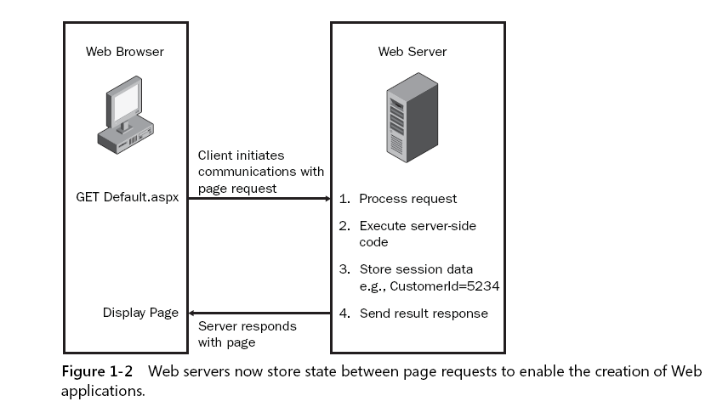
Understanding Web application development players

Slide 11
Understanding Web application development players
Web Server, Web Browser and HTTP
The Web browser initiates a request for a Web server resource.
HTTP is used to send the GET request to the Web server.
The Web server processes the request.
The Web server sends a response to the Web browser. HTTP protocol is used to send the HTTP response to the Web browser.
The Web browser processes the response, displaying the Web page.
The user enters data and performs an action, such as clicking a Submit button that causes the data to be sent back to the Web server.
HTTP is used to POST the data back to the server.
The Web server processes the data.
The Web server sends the response back to the Web browser.
HTTP is used to send the HTTP response to the Web browser.
The Web browser processes the response, displaying the Web page.

Slide 12
Agenda
Evolution of Web
What is Web Application?
Understanding Web application development players
Structure of Web Application
Major web application types
Complexity of web applications
Web application development process
Advantages / Disadvantages

Slide 13
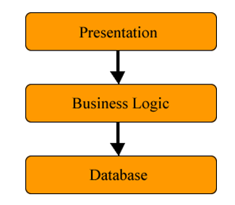
Structure of Web Application
Logical chunks called "tiers“
1-tiered to n-tiered applications
Most common 3-tiered application

Slide 14
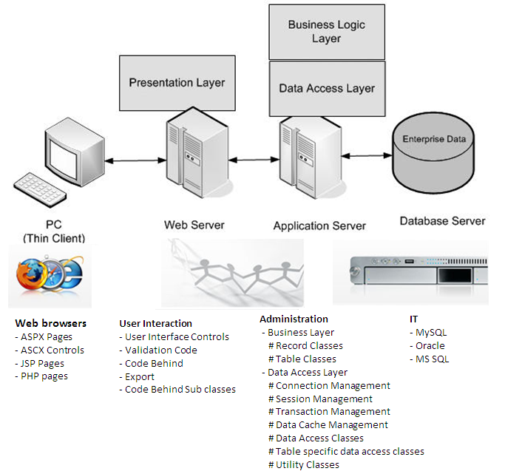
Structure of Web Application

Slide 15
Agenda
Evolution of Web
What is Web Application?
Understanding Web application development players
Structure of Web Application
Major web application types
Complexity of web applications
Advantages / Disadvantages

Slide 16
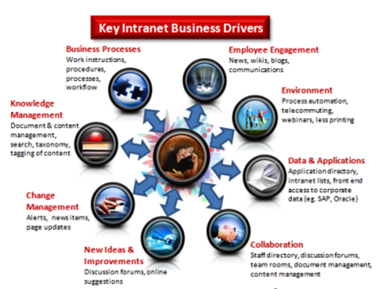
Major web application types
1. Intranet applications

Slide 17
Major web application types
1. Intranet applications
An intranet is a private Computer network.
It uses Internet Protocol to securely share information.
Intranet is used in contrast to internet.
Organization's internal web site.
Host multiple private websites
Used for internal communication and collaboration.
Can be used for
collaboration
corporate directories
Project management
Relationship management
Examples
http://indusa-sql/OTMS/jsp/common/login.jsp
http://indusabdc:8080/BTS/jsp/index.jsp

Slide 18
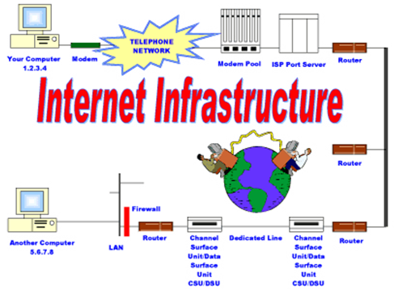
Major web application types
2. Internet applications / internet web sites

Slide 19
Major web application types
2. Internet applications / internet web sites
RIAs (Rich Internet applications)
Characteristics of desktop application like
Accessibility (AJAX based web sites, with Adobe Flash)
Advanced Communication (Google Map)
Complexity (design, development, deployment)
Consistency (cross platform compatibility)
Offline (smart client)
Security (SQL Injection, URL & Form Parameter and cookie, manipulation and Cross site scripting)
Performance (depending on network and kind of application has developed)
Richness of application (Video capturing is not supported by all web browsers)
Examples
http://www.wikimapia.org/#lat=23.043089&lon=72.5660706&z=10&l=0&m=b&v=6
http://www.backbase.com/company/?content=overview
http://www.meebo.com/
http://ondras.zarovi.cz/sql/demo/
http://store.nike.com/index.jsp?country=US&lang_locale=en_US#l=shop,pwp,c-1+100701/hf-10001+12002/t-Women's_Clothing

Slide 20
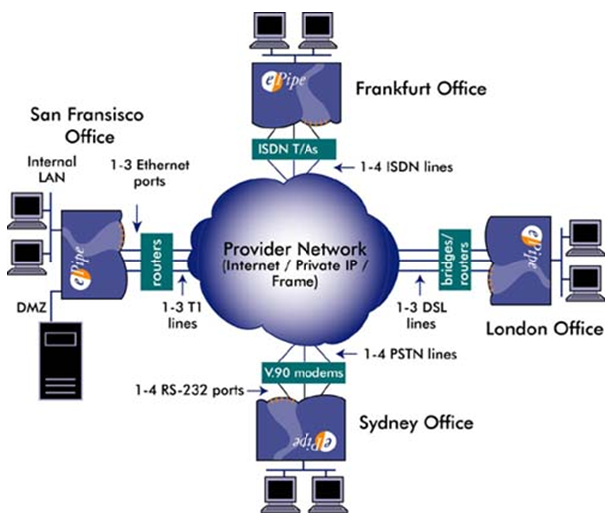
Major web application types
3. Extranet applications

Slide 21
Major web application types
3. Extranet applications
An Extranet is a private network
Uses Internet protocols, network connectivity and public telecommunication system to securely share part of organization’s information
Its part of intranet that is extended to users outside the company
Advantages:
Exchange large volume data
Collaboration, develop training programs
Sharing of data
Disadvantages:
Expensive to implement and maintain
Security can be concern
Examples (SharePoint, MS Exchange, IBM Lotus, Net meeting, live meeting etc.)
http://sportal/Pages/Default.aspx

Slide 22
Agenda
Evolution of Web
What is Web Application?
Understanding Web application development players
Structure of Web Application
Major web application types
Complexity of web applications
Web application development process
Advantages / Disadvantages

Slide 23
Complexity of web applications
Static web application
Same information for all users
Navigation through static documents
Advantages:
Quick and easy to put together
Ideal for prototyping
Can be cached
Disadvantages:
Difficult to maintain when becomes large
Difficult to keep consistent
Little visitor personalization

Slide 24
Complexity of web applications
Dynamic web application
Page layout and Content can be generated separately
Content is retrieved from database and present to user
Uses HTML and XHTML with image, text, form field etc.
Client side content generation
On user’s computer
Web browser retrieves a page from server, process the code (java script) and display content to user.
The “innerHTML” can illustrate client-side dynamic page generation
Server side content generation
Client sends request to server
Server receives the request and process server side script/ code based on query string, HTTP Post data or cookie etc.
Combine client and server content generation
AJAX, Flex, Java FX etc.

Slide 25
Agenda
Evolution of Web
What is Web Application?
Understanding Web application development players
Structure of Web Application
Major web application types
Complexity of web applications
Web application development process
Advantages / Disadvantages

Slide 26
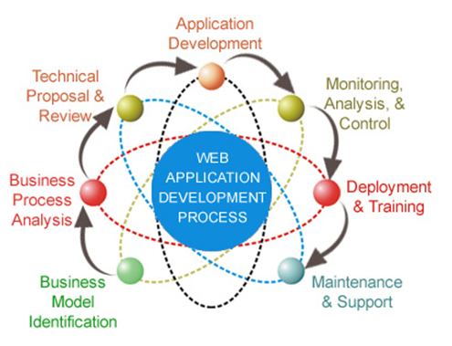
Web application development process

Slide 27
Agenda
Evolution of Web
What is Web Application?
Understanding Web application development players
Structure of Web Application
Major web application types
Complexity of web applications
Web application development process
Advantages / Disadvantages

Slide 28
Advantages / Disadvantages
Advantages
Requires little or no disk space on client machine
Centralized data is secure and easy to backup.
Updates can be made quickly and easily.
Information is accessible to a wide audience anywhere in the world.
Available 24 hours a day, 7 days a week.
Everybody has a browser - familiar interface encourages use.
Cross-platform compatibility (i.e., Windows, Mac, Linux, etc.)
Disadvantages
Slower, as run over the internet
Interfaces not as sophisticated
Can take longer to develop as they are more complex, have to work on different browsers, and different versions of browsers.
Security risks
Need of a dedicated machine(s) for web server

Slide 29
Difference between web and windows application
 | Windows Forms | Web Application
User Interfaces, data binding etc. | Easy to build | Difficult to build
Deployment and Maintenance | Complex. New versions of assemblies, configuration files, and other required files must be deployed on all client machines. Usually user interaction required. | Easy. Need to deploy assemblies and configuration files on the server only. Transparent to the client.
Performance | Faster | Slower
Robustness and Reliability | One client machine goes down, other users are still live. | Usually web servers are never down. However if the server goes down, all users are affected.
Network Congestion | Depending on the data transfer and connections made to the server from various clients. | Depends
Resources | Runs on the client machine. | Runs on a Web server.
Catastrophic failure | User interaction required. | Usually user interaction not required.
Framework dependency | All client machines have to install required versions of .NET framework and other required libraries. | Only server needs to have .NET framework and other required libraries.

Slide 30
Q u e s t I o n s
What is Web Server?
What is Web Browser?
What is the structure of Web Application?
What is Smart Client?

